Slide 1
Demonstration of operations on stack, queue, list
OOP project presented by Team 1

Slide 2

Overview
- Main task: design a program to display and explain some basic operations on list, queue, stack
- Requirement:
+ Use OOP to design the application
+ Build own data structure to demonstrate OOP design

Slide 3
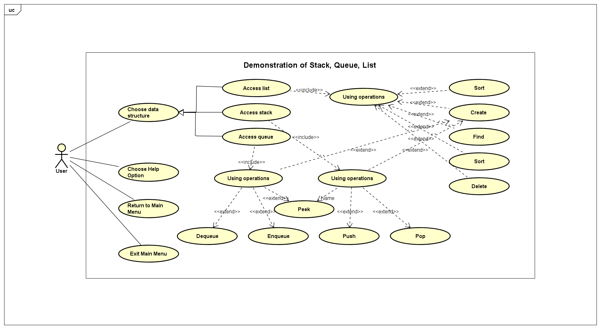
Use case diagram
Base on the requirements, we developed multiple use case as you can see in the above figure.

Slide 4
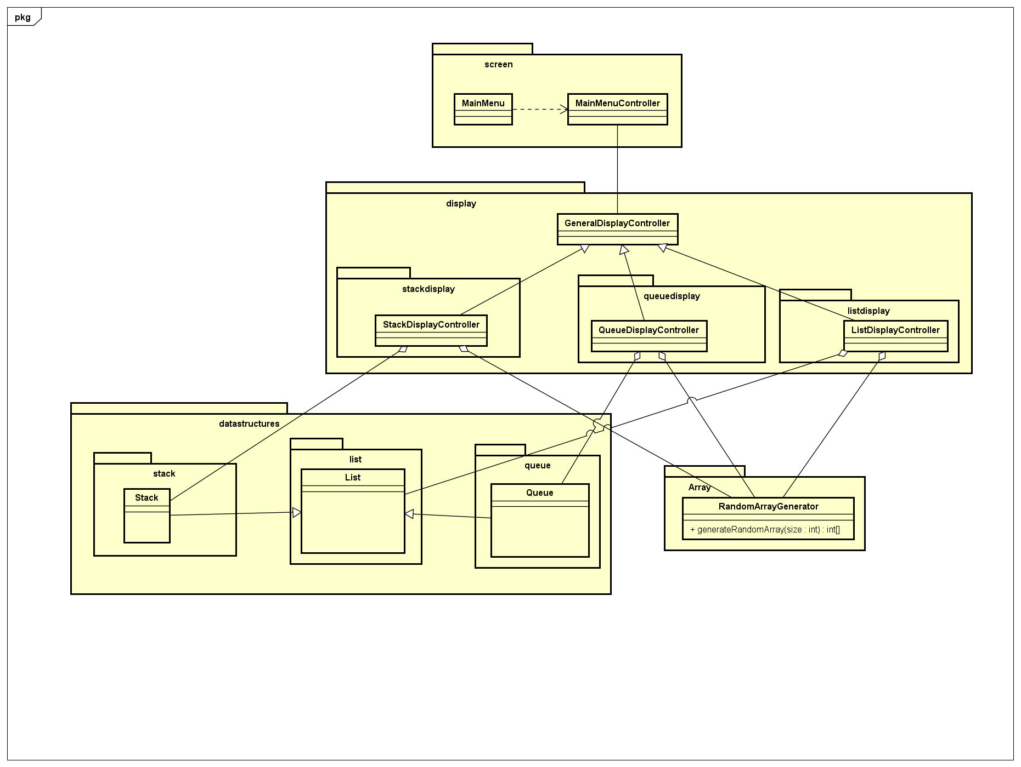
General class diagram
Packages: - Package “screen”: stores the main menu GUI and the main menu controller. - Package “display”: stores the controller for the display of stack, queue and list. In this package there are 3 smaller packages for the display of each datatype. - Package “datastructures”: stores our own implementations of 3 data structures: stack, queue and list. There are smaller packages for each type. - Package “array”: stores the random array generator.

Slide 5
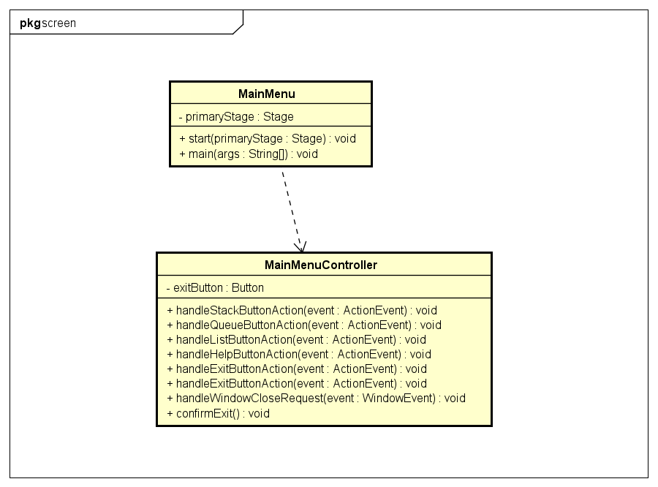
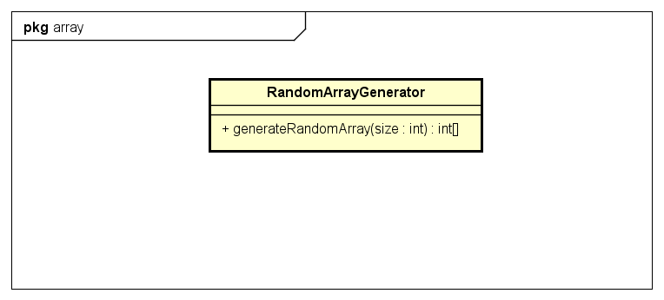

Slide 6
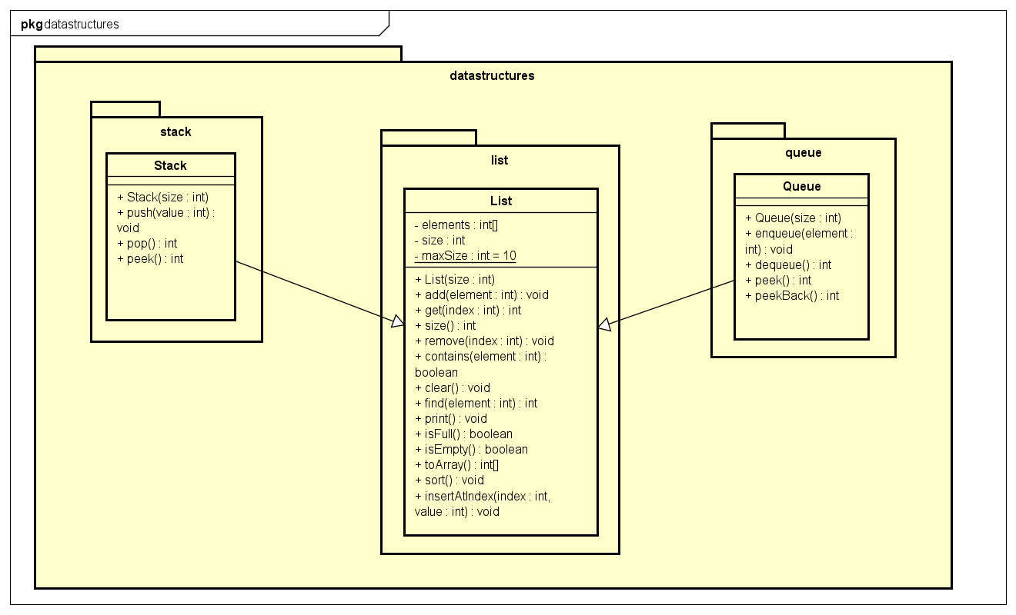

Slide 7
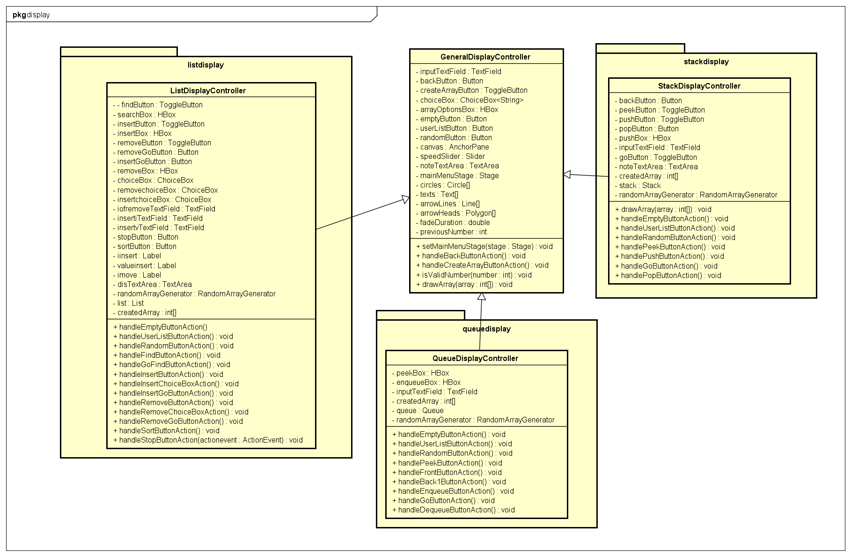

Slide 8
OOP design explaination
Encapsulation: Each class encapsulates its own data and behavior, exposing only necessary methods to interact with its objects. For example, the Stack class encapsulates the stack data structure and provides methods like push, pop, and peek to manipulate and access the stack.
Inheritance: The GeneralDisplayController class serves as a base class for the display controllers (StackDisplayController, QueueDisplayController, ListDisplayController). It encapsulates common functionality and UI elements shared by the display screens. The derived display controllers inherit from GeneralDisplayController and extend its functionality with stack, queue, or list-specific operations.
Polymorphism: The display controllers (StackDisplayController, QueueDisplayController, ListDisplayController) exhibit polymorphism as they all inherit from the same base class (GeneralDisplayController). This allows them to be used interchangeably in the main application, providing a consistent interface for interacting with different data structures.
Abstraction: The display controllers, such as StackDisplayController, QueueDisplayController, and ListDisplayController, abstract away the underlying complexity of the data structures they represent. They expose a simplified interface and handle the interactions between the user interface and the data structures.

Slide 9
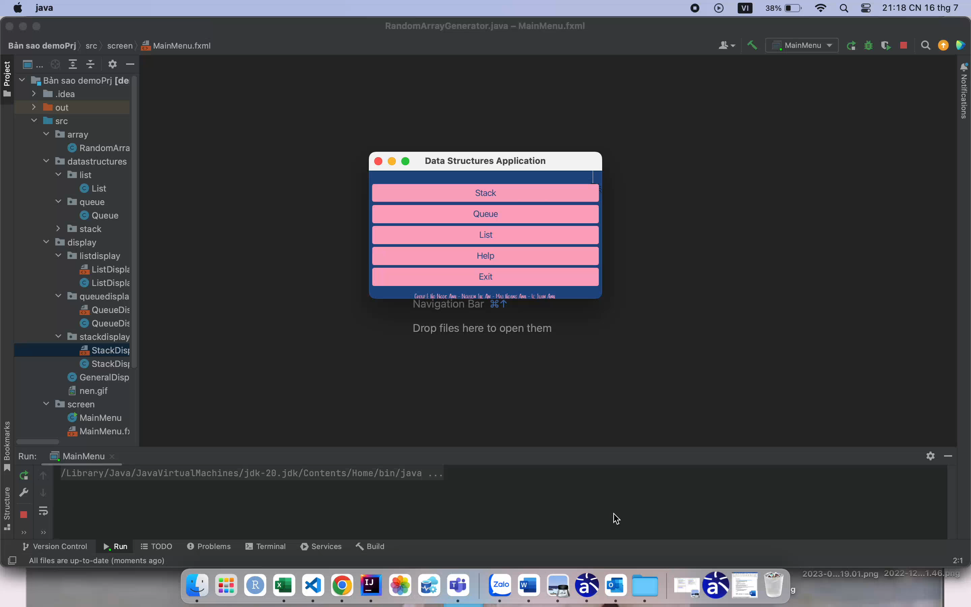
DEMO

Slide 10
THANKS!
Any question?

